Slide 1
Zhlukovacie algoritmy
Dominik Sopiak

Slide 2
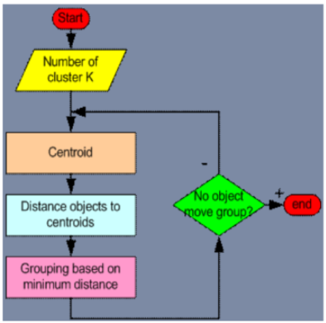

K-means
http://syskall.com/kmeans.js/
http://util.io/k-means

Slide 3
DBSCAN Density-Based Spatial Clustering of Applications with Noise
https://www.naftaliharris.com/blog/visualizing-dbscan-clustering/
DBSCAN (SetOfPoints, Eps, MinPts)
// SetOfPoints je nedefinovane
ClusterId := nextId(NOISE);
FOR i FROM 1 TO SetOfPoints.size DO
Point := SetOfPoints.get(i);
IF Point.CiId = UNCLASSIFIED THEN
IF ExpandCluster(SetOfPoints, Point,
ClusterId, Eps, MinPts) THEN
ClusterId := nextId(ClusterId)
END IF
END IF
END FOR
END; // DBSCAN

